Slide 1
AFSL LOGOS

Slide 2
AFSL

Slide 3
AFSL
Autonomous Flight
Systems Laboratory

Slide 4

AFSL

Slide 5
AIRCRAFT DECALS & STICKERS

Slide 6


Slide 7


Slide 8


Slide 9


Slide 10
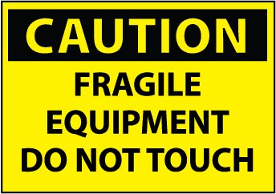
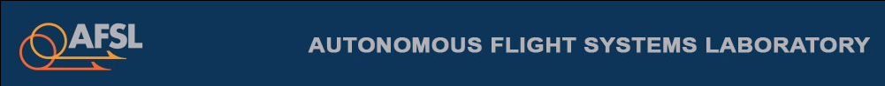


Slide 11
Aeronautics and Astronautics
Skywalker 1900
University of Washington

Slide 12
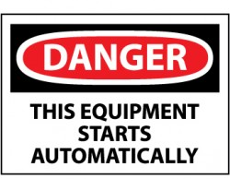



Slide 14




Slide 15


Slide 16
N680LU
N631VW

Slide 17
LAB COAT LOGOS

Slide 18
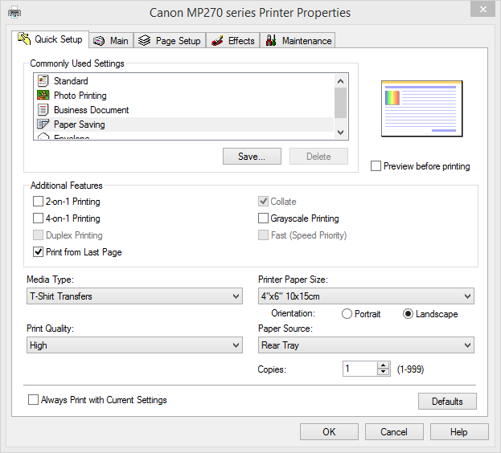
Instructions
Uncheck “2-on-1 Printing”
Change “Media Type” to “T-Shirt Transfers
Select size as 4” x 6”

Slide 20
Autonomous Flight Systems Laboratory

Slide 21


Slide 22
If found, please contact:
Christopher Lum
(206) 409-0204
(206) 543-0539
lum@uw.edu
AMA Member Number: 1061212
FCC HAM Radio Call Sign: KG7QEC
If found, please contact:
Christopher Lum
(206) 409-0204
(206) 543-0539
lum@uw.edu
AMA Member Number: 1061212
FCC HAM Radio Call Sign: KG7QEC
If found, please contact:
Christopher Lum
(206) 409-0204
(206) 543-0539
lum@uw.edu
AMA Member Number: 1061212
FCC HAM Radio Call Sign: KG7QEC
If found, please contact:
Christopher Lum
(206) 409-0204
(206) 543-0539
lum@uw.edu
AMA Member Number: 1061212
FCC HAM Radio Call Sign: KG7QEC
If found, please contact:
Christopher Lum
(206) 409-0204
(206) 543-0539
lum@uw.edu
AMA Member Number: 1061212
FCC HAM Radio Call Sign: KG7QEC
If found, please contact:
Christopher Lum
(206) 409-0204
(206) 543-0539
lum@uw.edu
AMA Member Number: 1061212
FCC HAM Radio Call Sign: KG7QEC

Slide 23
ANAKIN
FUNRA
HAPRA
TEDD
LUKE
LEIA

Slide 24






Slide 25


Autonomous Flight Systems Laboratory

